Slide 1

Women’s v. Men’s Tennis:
Is the WTA really more “inconsistent” than the ATP?
Notes:
*Introduce names.* So, we looked at women’s versus men’s tennis. Specifically, we wanted to examine the question: “Is the WTA really more ‘inconsistent’ than the ATP?”
https://docs.google.com/document/d/11-V7P1EG7NLjWjj1JdoiqWlm32i4D08_XL49VS4Ifxw/edit?usp=sharing

Slide 2
WTA
ATP
Grand Slams (GS)
Women’s Tennis Association
Association of Tennis Professionals (Men’s Tennis)
The four biggest tournaments in tennis.
Notes:
First, here are some terms that you should know.
WTA stands for Women’s Tennis Association,
ATP stands for Association of Tennis Professionals, and
the Grand Slams consist of the four biggest tennis tournaments, namely the Australian Open, French Open, Wimbledon, and US Open.

Slide 3

Motivation
Notes:
How did we come to this topic? Well, for one, Chris is a big tennis fan.
With regards to this question of inconsistency, as you may or may not know, Emma Raducanu recently won the US Open as a qualifier, meaning her ranking wasn’t even high enough to enter the tournament directly. On the other hand, the men’s final was between the top 2 ranked players of the tournament.
Since we began following tennis in the early 2010s, this tournament is merely one example of a larger theme in the mainstream perception of women’s tennis as more unpredictable and less consistent than men’s tennis.
We wanted to break down this idea, see how much data supports this perception, and learn more about the specific differences that might influence this perception.

Slide 4



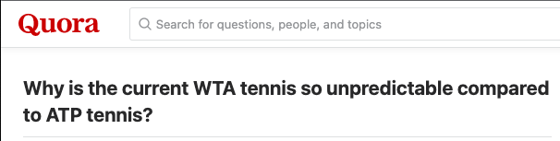

Notes:
Here are some headlines on different social media sites that discuss tennis that demonstrate this perception of more inconsistency found in the WTA. *reads out headlines*: mention that the WTA Tour is the official WTA website (1:20)

Slide 5
About the Dataset
On the state of tennis data…
tennisabstract.com
csv for each year
Downloading
All data from 1968-2021
Notes:
First, we’re going to play a short clip speaking on the state of tennis data. *plays video*
The person who we just saw speak is one of the pioneers of widely accessible tennis data. His name is Jeff Sackmann, and he is the owner/creator of the datasets that we used, which can be found at his GitHub and his website.

Slide 6
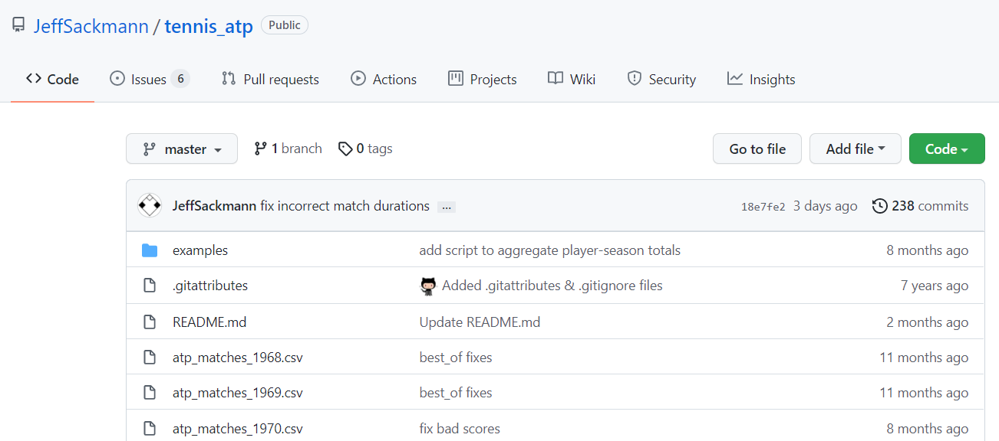
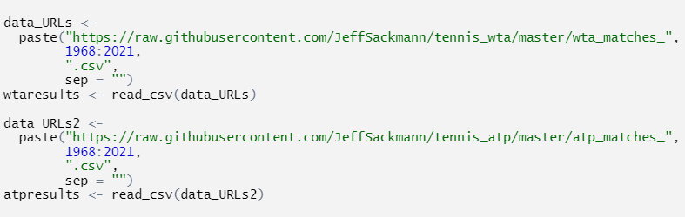
Our data collecting process
Notes:
We focused on the two repositories tennis_atp and tennis_wta. They contain the exact same data except one is for men’s and the other is for women’s tennis.
Each calendar year had a separate csv file, which contained an entry for every tennis match that occurred on the main professional tour that year. Additionally, it contained some match statistics about service and return performance of the winner and loser. Serve is the shot in tennis that starts the point, and return gives information about performance of a player receiving the serve. You can see a full list of variables and definitions in the handout that we gave you.
(*show second img*)
Because every dataset had the same URL except for the year, we used a paste function to make a list of all the datasets for each tour from 1968, which was the start of the Open Era where amateurs were allowed to compete with professionals, to the current 2021 season. That list of URLs was then run through read_csv to make one dataset each for the WTA and ATP. After mutating a column that specifies whether the observation is a match from the WTA or the ATP, we merged the datasets together to get our combined dataset.

Slide 7
About the Dataset
Wrangling
Moderately tidy!
Still required a lot of time
Notes:
Despite the dataset being shockingly tidy, the data wrangling still required a lot of time due to fixing entry errors and accidental duplications, and mutating new variables that we needed. We also used lubridate to create a usable date, year, and month column, and filtered out results that were exhibition, junior, or challenger level matches in order to focus on the main professional tour.
1:20+2:25=3:45

Slide 8
How do we measure (in)consistency?
1. Top Player Performance
Exploring GS winners
Permutation test
2. Playing Styles
the most visual element of the game
Men’s tennis is more “exciting” or “HQ?”
Cluster analysis
3. Rankings
gganimate: top 5 players over time
How dominant are the top 10 players?
# of different top 2 players
Permutation test
Notes:
Back to our research question of whether the WTA tour is more inconsistent than the ATP tour, we first had to figure out how to measure this concept of “(in)consistency,” and we ended up deciding on what we believe to be three of the most public-facing measures of consistency. 1: Top Player Performance at the biggest tournaments, which are the Grand Slams, 2: Playing Style Comparison between the tours, and 3: the ranking dominance of the top players and the number of unique players who achieve top ranks per year
First, most people only know the top players of the WTA and ATP such as Serena, Naomi Osaka, Venus, Federer, Nadal, and Djokovic. We didn’t have the capacity to examine the highlighted variables. However, most people only know the most visible tournaments, the Grand Slams, so we looked at the average rank of grand slam winners over time and used a permutation test to explore if the difference in average rank was meaningful.
Second, the playing style of different tennis players is the most visual part of the game. For example, do you hit the ball really hard, do you play the percentages, do you play with a lot of variety and come to the net? There is another sentiment expressed in tennis circles that men’s tennis is more “exciting” or “high quality,” so we wanted to break this perception down more specifically. We performed a cluster analysis to find different groups of playing styles and compared them between the tours.
Finally, we looked at the rankings. We played around with gganimate. We explored the dominance of the top 10 players using ranking points, which we’ll explain the ranking system later. Building off the idea of the Big 3 or Big 4 that was referred to in one of the headlines, we looked at the number of unique top 2 players on each of the tours and used another permutation test to see if the relative change in the difference of unique top 2 players between tours was significant.
Looking at the top 10:
- Win %
- #/% of tourney wins
- Upsets
3:45+1:30=5:15

Slide 9
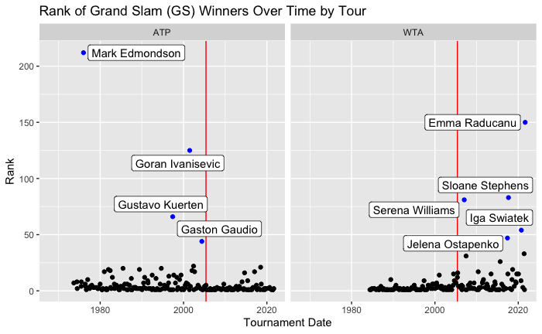
1. Rank of GS Winners over Time
Notes:
Here we see a graph of the rank of grand slam winners over time split by the two tours. Most of the winners, as expected, are very highly ranked so they are low on the y-axis. The biggest thing to note is the outliers, which are labeled. All of the men’s outliers occurred before 2005, marked by the red lines, while all of the women’s outliers occurred after 2005.
We performed a permutation test by permuting the ranks of Grand Slam winners across ATP and WTA players. Since our null hypothesis is that there is no difference in average winner rank across the tours, it shouldn’t matter if we permute the ranks across everyone and recalculate the difference.

Slide 10
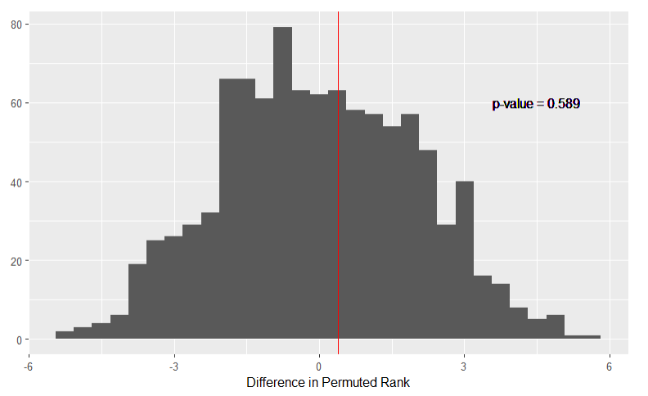
1. Is the average rank of GS winners significantly different across tours?
Notes:
And it turns out that we get a big p-value of 0.589, which means we fail to reject the null hypothesis. Thus, there is no significant difference in average player rank of Grand Slam winners across the ATP and WTA tours.
(9-10: 50 sec; total: 6:05)

Slide 11

2. Playing Styles
Cluster analysis of playing styles using match statistics.
Notes:
Next, we will talk about playing styles. We used k-means clustering with k=4 clusters in order to group together players by playing style/player type. We then compared the clusters and put the results into a Shiny app.

Slide 12
Are female players bad at serving and/or good at returning?
Are male players good at serving and/or bad at returning?
Notes:
So, the crux of this question is how do you frame this difference? Because serve and return are directly connected, is the difference we see in the clusters because female players are bad at serving and/or good at returning? Are male players good at serving and/or bad at returning? In my tennis experience, the game has a bias towards serving, so male players are framed as having “strong” serves and female players “weak” serves instead focusing on their returns. I might argue that this difference is rooted in sexism, or at least has a differential impact on the perception of the women’s game. Women’s players are seen as lower quality, less consistent, less stable perhaps in part due to the serving bias.
+2:00=8:05

Slide 13
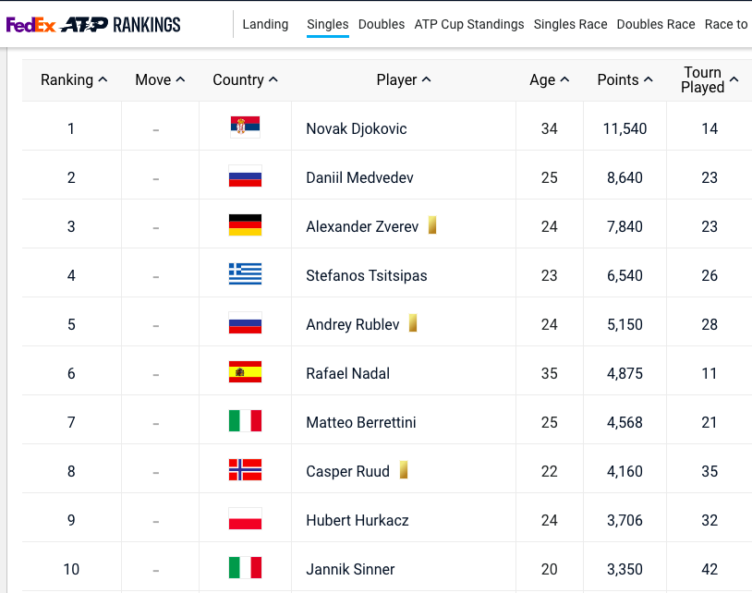
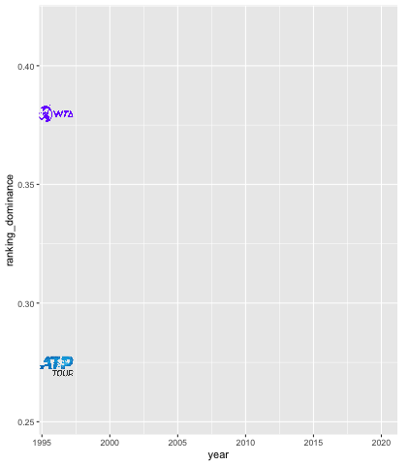

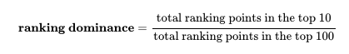
3. Rankings
Notes:
Finally, we examined the rankings to get at this question of inconsistency. In the ranking system, you basically get more points the better you perform in a tournament. So, the more dominant the top players are, the higher the proportion of points that they should have relative to the rest of the tour. From this animation, we can see that there is a clear change in “ranking dominance” around 2007. The top women were more dominant before that time, while the top men were more dominant afterwards. This corresponds with the rise of the Big 3 or Big 4 in men’s tennis.
Proportion of points that are contained in the top 10

Slide 14
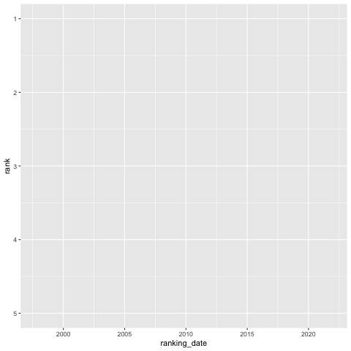
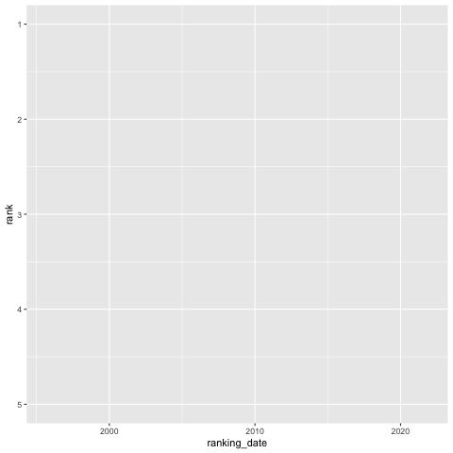
3. Active Players in the Top 5
Notes:
So, here is a fun little animation of current players who have not retired and have reached the top 5 in the rankings at some point in their career. Look at how it’s the same 3 or 4 players on the men’s side for a very long time, while on the women’s side, besides Serena, there are more changes happening and more gaps, which indicate that those unpictured players who have reached the top 5 at some point have retired and have not had the same longevity as the men’s top players (at least recently).

Slide 15

The “Big 4” of Men’s Tennis
Nadal
Federer
Djokovic
Murray
Notes:
So, what is the big 4 or big 3? These 4 players were ranked in the top 4 of men’s tennis for basically a whole decade, as you might have seen from the previous animation. Between them, they’ve won 63 Grand Slams. They basically reach the last rounds of every single tournament they play, etc. etc. They have been super dominant since the rise of Federer around 2005.

Slide 16
When was the last time someone outside of the Big 4 was ranked #1 or #2?
Notes:
Clicker question to demonstrate the dominance of the Big 4! When was the last time someone outside of the Big 4 was ranked #1 or #2? Before this year.

Slide 17

July 2005!
Notes:
July 2005! Earlier this year in March 2021, Daniil Medvedev became the first player to break the top 2 in the rankings outside of Federer, Djokovic, Nadal, or Murray in 16 years.

Slide 18
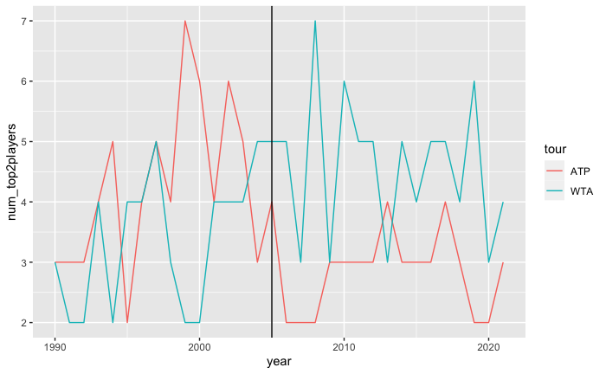
3. # of Unique Top 2 Players
Notes:
So,we made a graphic that shows how many different players make it to the top 2 in the rankings for that calendar year. This statistic has been fluctuating more for the WTA since 2003 while it fluctuated more for the ATP before 2003. This is the very similar to the trends we saw before with the GS winner ranking graph and the ranking dominance by tour graph! (Though correlation is not causation but I think we have a fairly strong case here).

Slide 19
Average # of Unique Top 2 Players
 | Before 2005 | After 2005 | Difference
WTA | 3.4375 | 4.5625 | +1.1250
ATP | 4.2500 | 2.8125 | -1.4375
Difference (between WTA & ATP) | -0.8125 | +1.7500 | +2.5625
Notes:
To put it more concretely, before 2005, the WTA had on average 0.8125 less players reaching the top 2 than the ATP, but after 2005 this changed to almost 2 more players more who reached the top 2 ranks. The difference before and after 2005 between the tours has increased by around 2.5 players, meaning that the average number of unique top 2 players has increased in the WTA, while that of the ATP has decreased.

Slide 20
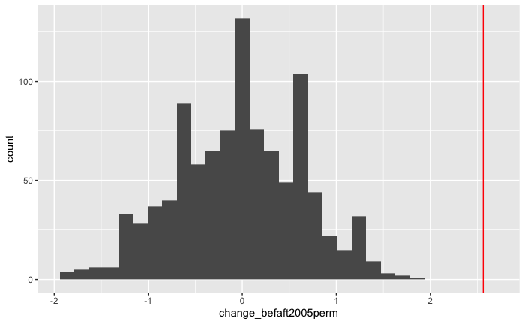
3. Is the change in # of top 2 players between tours significant?
Notes:
Then, we also performed a permutation test by using the change in tour differences before and after 2005 as our statistic. Here, we can clearly see that this change would have almost impossible to be observed under the null distribution simulated here, meaning we reject the null and conclude that the change in difference before and after 2005 is indeed significant.

Slide 21
So, is the WTA more inconsistent?
GS winner rank is not significantly different visually nor by our first permutation test.
Men seem to have more stronger servers while women seem to have more stronger returners.
There has a been a significant shift in the difference in # of unique top 2 players before and after 2005 between the tours.
1
2
3
1
3
?
For GS winner rankings, outliers for men are before 2005 while the outliers for women are after 2005.
Top women have been less dominant than top men recently, but more dominant before ~2008.
What can we conclude?
Notes:
To recap our specific findings…
Cluster Findings: From the serving bias in tennis, we theorized the lower serving stats of the women’s tour influences the more inconsistent perception of women’s tennis.
Third point: … but tennis as a game seems to be biased towards people who have better serves, which disparately impacts the perception some people have on women’s tennis.

Slide 22
Conclusions
While there are differences, the perception of the WTA’s inconsistency is influenced, in part, by the following:
a bias in tennis towards servers
the recency effect
the current generation of top players
Notes:
While there are differences, the perception of the WTA’s inconsistency is influenced, in part, by the following:
A bias in tennis towards servers which might recognize women’s strength in return instead as a weakness in serve.
The recency effect, where our memory is skewed towards the more recent results of the last few years with the dominance of the Big 4 on the ATP tour, when, if anything, the WTA was shown to be more consistent than the ATP before 2005.
The current generation of top players. Perhaps this is the natural cycle of new players coming in and out, or it’ll be a more permanent trend lasting into the future. The Big 4 is getting older towards retirement age, so perhaps the ATP will follow suit soon and have more variety at the top of the game.

